Slide 1
WIH3001 Data Science Project 2023/2024
LEARNING OBJECT CLASSIFICATION BASED ON PERSONALISATION
DATA SCIENCE PROJECT PRESENTATION
BY: JANICE CHONG SEE WAI (S2132420)
SUPERVISED BY: AP. DR. NOR LIYANA BT MOHD SHUIB

Slide 2





02
Introduction
Problem Statment
Overview
Objectives
Data Science Methodology
Demonstration

Slide 3



03
Introduction: Overview
Visual
takes into account the
each has a preferred
Learning Style
comprises
Learning Objects
Personalisation
Auditory
Kinesthetic
such as
Audio-Recorded Lecture
Educational Game
Interactive Tool
Mind Map
Real Object Model
Video
Animated Instruction
Book
Intelligent Computer-Aided Instruction Systems
Lecture Notes
Multimedia Content
Slide Presentation
Technology-Supported Learning Include Computer-Based Training Systems
Notes:
My topic focuses on 3 key terms; personalisation, learning style and learning object.
personalisation takes.....read slides.

Slide 4



2.0
1.0 Personalisation
04
Introduction: Background
Key to improving learning performance (Martin & Maria, 2019)
According to Souabi et al., 2021, tailoring learning objects to align with students' learning styles and preferences can:
Enhance educational experience
Increases learners' performance and satisfaction
Learning
Notes:
So what exactly do the 3 key terms mean?
Personalisation in learning can be done by tailoring learning objects that align with the learners' learning styles and preferences. This enhanced the educational experience and increased learners' performance and satisfaction.

Slide 5




2.0
1.0 Personalisation
05
Introduction: Background
Key to improving learning performance (Martin & Maria, 2019)
According to Souabi et al., 2021, tailoring learning objects to align with students' learning styles and preferences can:
Enhance educational experience
Increases learners' performance and satisfaction
Learning
2.0 VAK Model
Provides the learners with a profile of their learning styles (Rao, 2023)
Understand the type of learning that best suits them
People learn by:
Seeing (Visual)
Hearing (Auditory)
Doing (Kinesthetic)
Notes:
Secondly, Learning style is the way a person learns and processes information. In this project, we will be using the VAK Model as our learning style model. A learning style model allows learners to understand the type of learning that suits them best. According to the VAK Model, people learn either by seeing for visual learners,hearing for auditory or doing for kinesthetic learners.

Slide 6


2.0
1.0 Personalisation
06
Introduction: Background
Key to improving learning performance (Martin & Maria, 2019)
According to Souabi et al., 2021, tailoring learning objects to align with students' learning styles and preferences can:
Enhance educational experience
Increases learners' performance and satisfaction
Learning
3.0 Learning Objects
Any entity, digital or non-digital that can be used, re-used or referenced during technology-supported learning (Demir & Almali, 2020)
In a world of information overload, students today are exposed to extensive learning objects.
2.0 VAK Model
Provides the learners with a profile of their learning styles (Rao, 2023)
Understand the type of learning that best suits them
People learn by:
Seeing (Visual)
Hearing (Auditory)
Doing (Kinesthetic)
Notes:
Lastly, we have the learning objects.
In simple terms, 'Learning objects' is any material that is used for learning.

Slide 7
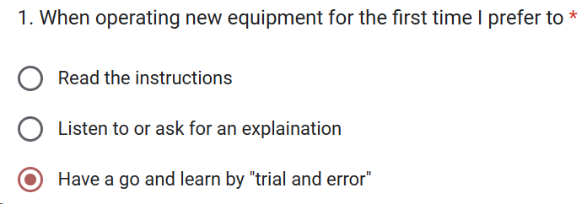

2.0
07
Introduction: VAK Model
a. VAK learning style questionnaire
30 statements, each with 3 options (created by Chislett and Chapman in 2005).
Respondents will need to choose the options which best describe them.
Example based on Figure 1:
A visual learner would most probably choose to read the instructions
An auditory learner would prefer to listen to an explanation
A kinesthetic learner is likely to have a go directly
Figure 1: Sample VAK learning style question from the survey form
b. Determination of dominant learning style
Each option of the VAK questions represents a dominant learning style (either Visual, Auditory or Kinesthetic).
Sum the responses based on V, A, K.
The maximum sum indicates the dominant learning style of the respondent.
Visual
See & Read
Auditory
Kinesthetic
Listen & Speak
Move & Do
Notes:
A little bit more in-depth explanation of how the Vak model works.
Every learner can obtain their dominant learning style by answering the Vak learning style questionnaire. It consists of 30 statements with 3 options each. The respondent will need to choose....
Take fig 1 as an example, ....
Each option represents....
The options selected will then be summed according to the respective option type, either V, A or K.
Finally, the option type with the maximum sum indicates the dominant learning style.

Slide 8
08
Problem Statement: Literature Analysis 1
a. Effective learning through personalisation of learning objects
References | Main Topic | Actions | Findings | Limitations
Souabi et al. (2021) | Emphasised the need for recommendation systems due to the large amount of learning material | Proposed a recommendation systems with the integration of machine learning algorithms. | Stressed the importance of tailoring learning objects to align with students' learning styles and preferences | Did not specify any machine learning algorithm to use
Nabizadeh et al. (2020) | Sequence of learning objects recommendation that accommodate to the users' time constraints while maximizing their scores | Specify learning objects to a course Perform Depth First Search to find all paths (LO sequences) | Recommended learning objects did help students to get better grades | Does not account to learning style and learning object preferences Did not utilise machine learning models
Table 1: Journal references - 1
Notes:
the statement effective...
can be supported by 2 researches in Table 1.
In short, research by Souabi in 2021 emphasised the need for... The paper also proposed a ...
Another research by Nabizadeh in 2020 noted that recommending learning objects did help students get better grades.

Slide 9
09
Problem Statement: Literature Analysis 2
b. Learning objects recommendation systems
References | Main Topic | Method Used | Findings | Limitations
Nafea et al. (2019) | Learning object recommendation tool based on learning style and learning objects ratings. | Collaborative Filtering (CF) Content-Based Filtering (CBF) Hybrid filtering (HF) | Hybrid filtering is the best approach Majority (95%) of the students were satisfied with the LO recommendations from the HF algorithm | Further experiments needed using different personalisation strategies
Syed et al. (2017) | Personalised learning object recommendation system architecture based on learning object preferences | Hybrid filtering | Suggested technical measures for evaluating recommendation systems, such as accuracy and performance | Did not train or evaluate any model Did not consider the aspect of learning styles
Imran and Abdullah (2010) | Learning object recommendation tool based on outstanding learners’ ratings on the learning objects | Content-based filtering (CBF) Peer-review mechanism SVM to calculate objects similarities | Proposed system has better precision as compared to an e-learning with the usual content-based recommender system | Does not reflect all learners' preferences accurately.
Table 2: Journal references - 2
Notes:
Table 2 focuses on previous research on learning object recommendation systems.
To sum it up, All of them use the mainstream recommendation algorithm which is the filtering method. Although the research did have a positive outcome whereby students are satisfied and the system is performing well, there are some limitations for each research. Some key limitations are the paper only suggested a recommendation method but did not actually built it. Additionally, some did not take learning style into account and the learning objects' preferences do not reflect all learners' preferences.

Slide 10
Problem Statement: Literature Analysis 3
10
Glossary:
c. Classification algorithms comparisions
Naive Bayes - NB
k-Nearest Neighbour - kNN
Decision Tree - DT
Random Forest - RF
Support Vector Machine - SVM
Logistic Regression - LR
Connected Neural Network - CNN
eXtreme Gradient Boosting - XGB
References | Journal Title | Models | Results | Limitation
Deng et al. (2023) | Comparison of multiple machine learning algorithms for music genre classification | NB, kNN, DT, RF, SVM, LR, CNN | CNN and kNN has the highest accuracy (~90%) Naive Bayes has the lowest accuracy of (~51%) | CNN is computational expensive
Nazish et al. (2021) | COVID-19 Lung Image Classification Based on Logistic Regression and Support Vector Machine | SVM, LR | SVM achieved the highest accuracy of 96% LR records 92% accuracy | Only compares 2 classification models
Santana et al. (2021) | Classification Models for COVID-19 Test Prioritization in Brazil: Machine Learning Approach | DT, RF, XGB, kNN, SVM, LR | DT, RF, XGB, and SVM models have similar accuracy results (~89% accuracy). Paper chose DT as the best due to its interpretability. | Not specified
Kebonye (2021) | Exploring the novel support points-based split method on a soil dataset | 4 percentage ratios of 60/40, 70/30, 75/25 and 80/20. | 70/30, 75/25 and 80/20 ratios have similar score | Not specified
Table 3: Journal references - 3
Notes:
As previous research did not use any classification algorithm, Table 3 focuses on comparing classification algorithms to identify the possible algorithms to be used in this project.
Additionally, research by Kebonye in 2021 also noted that the percentage ratio partitions of 70/30, 75/25 and 80/20 have similar score.

Slide 11
11
Problem Statement: Summary
01. Finding the most suitable learning objects for effective learning is a challenge
The enormity of the amount of learning objects has led students to have difficulties in determining the most suitable learning objects for them (Souabi et al., 2021).
02. Limited classification models have been developed for learning objects
based on learning style and learning object preferences
Previous research only focuses on mainstream recommendation algorithms (Nafea et al., 2019; Syed et al., 2017; Imran and Abdullah, 2010).
Past research does not take into account both the student's learning style (Imran and Abdullah, 2010) and learning object preferences (Nafea et al., 2019).
Notes:
Thus, we can conclude 2 problem statements.
First,
Second there is no classification....

Slide 12
12
Objectives
To develop a learning object classification based on personalisation model
To evaluate a learning object classification based on personalisation model
To develop a functional data product web application which can provide learning objects recommendation
Notes:
3 objectives were defined.

Slide 13
13
Data Science Methodology
Business Understanding
Data Understanding
Data
Preparation
Data
Deployment
Modelling
CRISP-DM
Evaluation
Notes:
CRISP-dm framework is utilised in this project.

Slide 14
14
DS Methodology: Business Understanding
a. Scope
Learning style i.e., VAK Model
Learning objects
01. Understand the Domain
c. Define objectives
b. Study previous researches
Notes:
First and foremost, the business understanding phase involves defining the scope, studying previous research and defining project objectives.

Slide 15
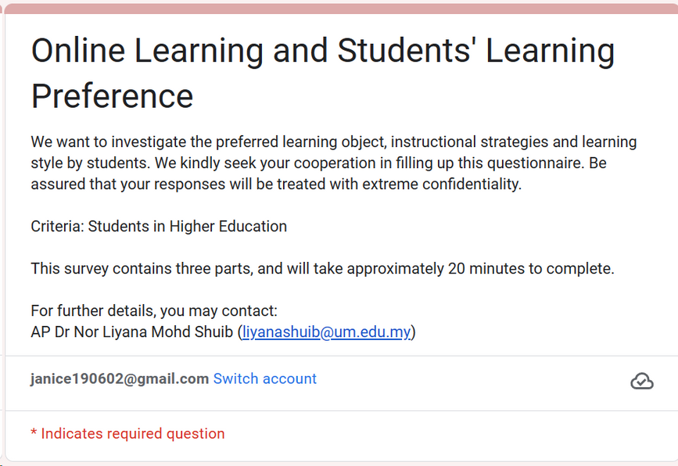
15
DS Methodology: Data Understanding 1
a. Obtained from a survey
Distributed to students of Universiti Malaya from year 2021 - 2022
02. Understand the Data
b. Data Size
1036 rows, 104 columns
Figure 2: Survey form
Notes:
Second, is the data understanding phase. The dataset is obtained from a survey, distributed to... from year 2021 to 2022. It consists of 1036 rows, and 104 columns.

Slide 16


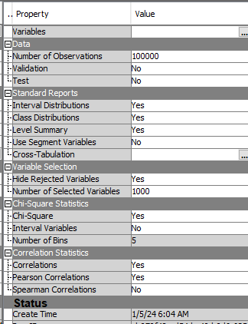
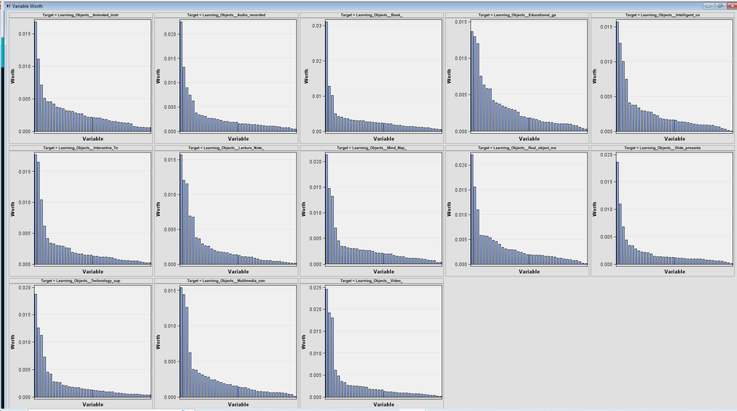
16
DS Methodology: Data Understanding 2
a. Use SAS Enterprise Miner
Chi-square measure
To determine columns that have a link to the target variables
03.
Choose relevant columns
Figure 3: Nodes built in SAS
b. Columns identified
Gender
Level of study
Household income
Preferred learning mode
Preferred communication platform
Learning objects preferences
VAK learning style questions
Figure 4: StatsExplore parameters & output
Notes:
As the dataset has too many columns, we need to identify the relevant columns. thus, SAS enterprise miner is utilised here.
The chi-square measure is set in the statsexplore node to identify the input variable worth to target.
The graphs in Figure 4 gives the columns that have a link to the target variables, from the strongest to the weakest.
From there, the relevant columns are identified.

Slide 17
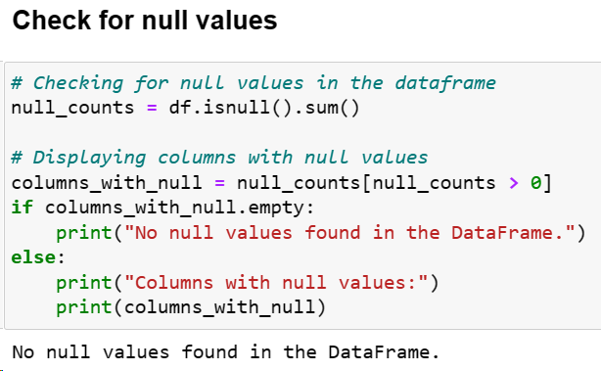
17
DS Methodology: Data Preparation 1
04.
Check for null values
No null values found
Figure 5: Code snippet of null value checks
Notes:
The third phase is the data preparation where we begin by checking for null values.

Slide 18
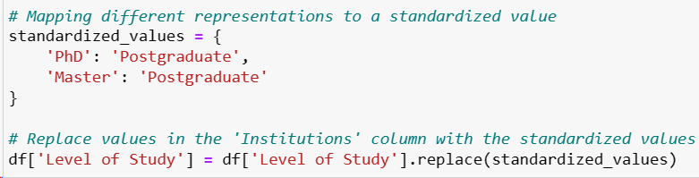
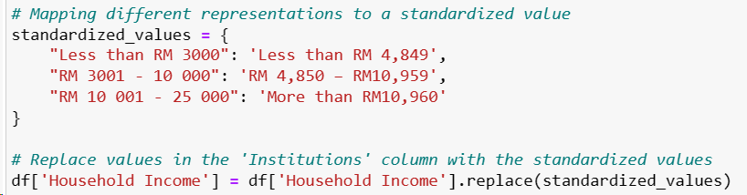
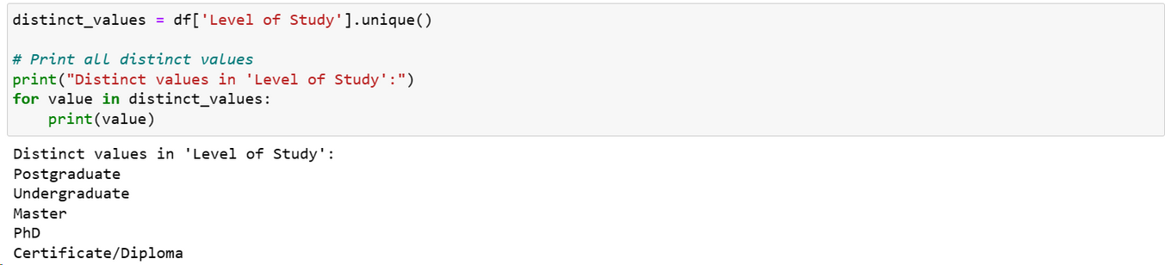
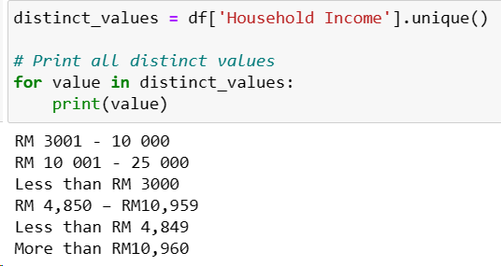
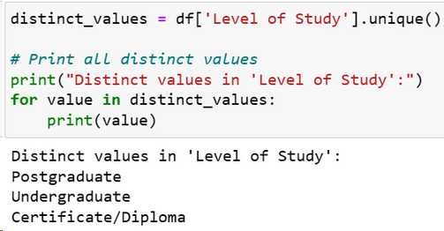
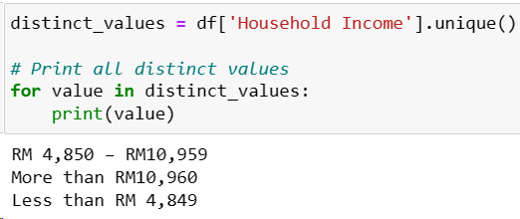

18
DS Methodology: Data Preparation 2
05.
Perform data Standardisation
Figure 6: Code snippet of mappings values by defining dictionary
a. Fix all data inconsistencies
Used mappings by defining dictionary and replace the values respectively
Figure 7: Original values in the ‘Level of Study’ & ‘Household income’
After standardisation
Figure 8: Standardised values in the ‘Level of Study’ & ‘Household income’
Notes:
After that, Data standardisation is performed by mapping the values respectively.
Figure 8 shows the result after standardising.
This step is important for a more accurate analysis and interpretation of the data

Slide 19
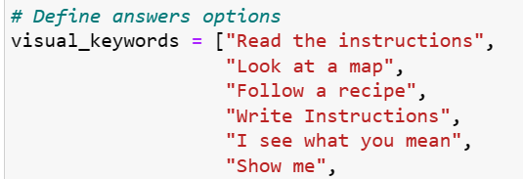
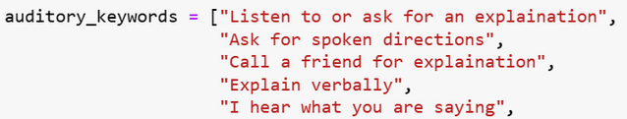
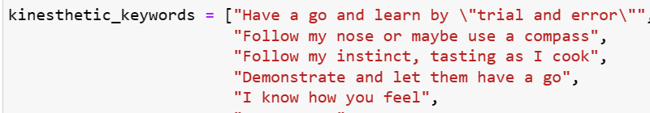
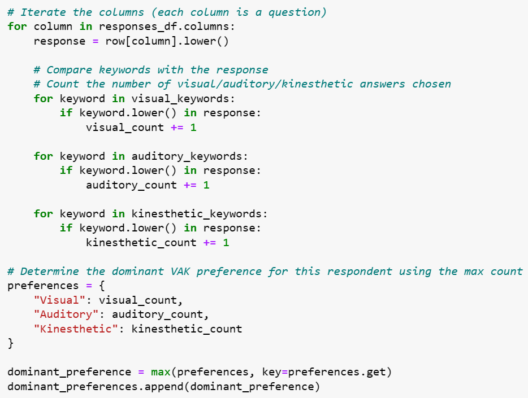
19
DS Methodology: Data Preparation 3
06.
Determine
the dominant learning style
a. Define answer options to their respective learning style.
Figure 9: Define answers to their respective dominant learning style; V, A, K
b. Calculate the sum of V, A, K options selected respectively.
c. Get the maximum sum and append it as a new column
Max sum represent the dominant learning style
Figure 11: Get the learning style with the maximum sum
Figure 10: Summing the options chosen
Notes:
Next, we need to compute the dominant learning style for each respondent.
The detailed steps have been explained previously.

Slide 20

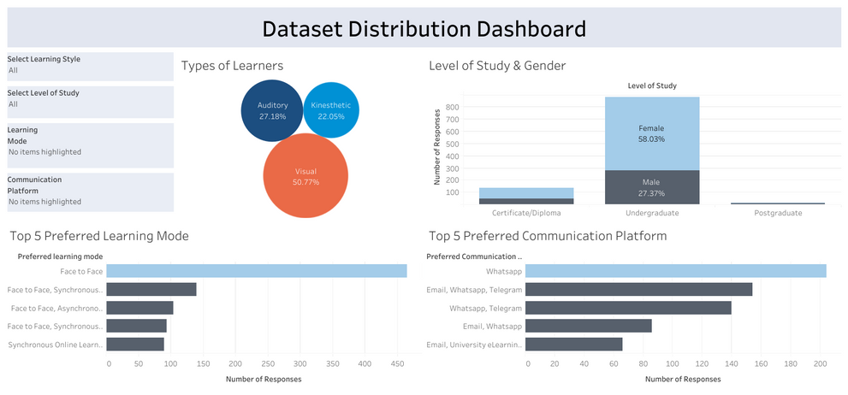
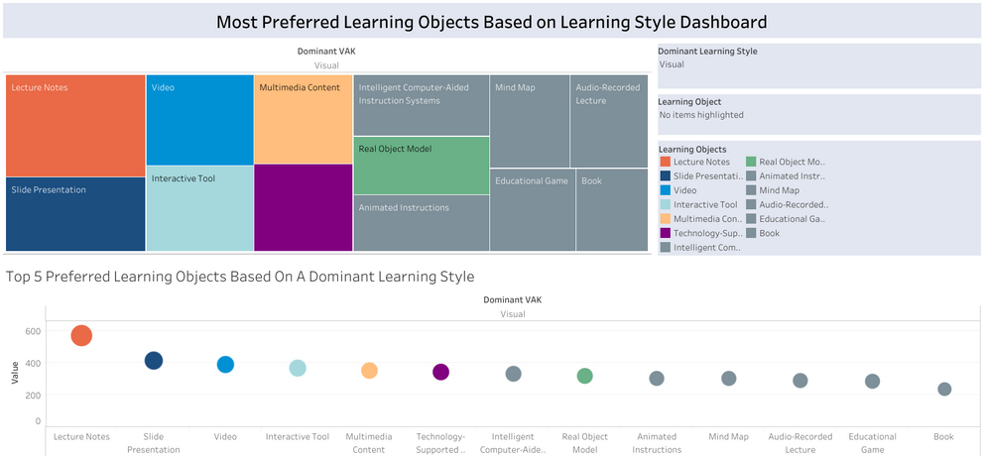
20
DS Methodology: Data Preparation 4.0
07.
Perform EDA
a. Created 2 dashboard
Dataset General Distribution
Learning Objects Preferences
Figure 12: General distribution dashboard
Figure 13: Learning objects preferences based on learning style
Link to dashboard: General Distribution Dashboard
Link to dashboard: Learning Objects Preferences
Notes:
Then, exploratory data analysis is performed to gain insights into the general distribution and learning object preferences of the respondents. Fig 12 and Fig 13 are the dashboard respectively.
We will look into the individual graphs in the next slides.

Slide 21
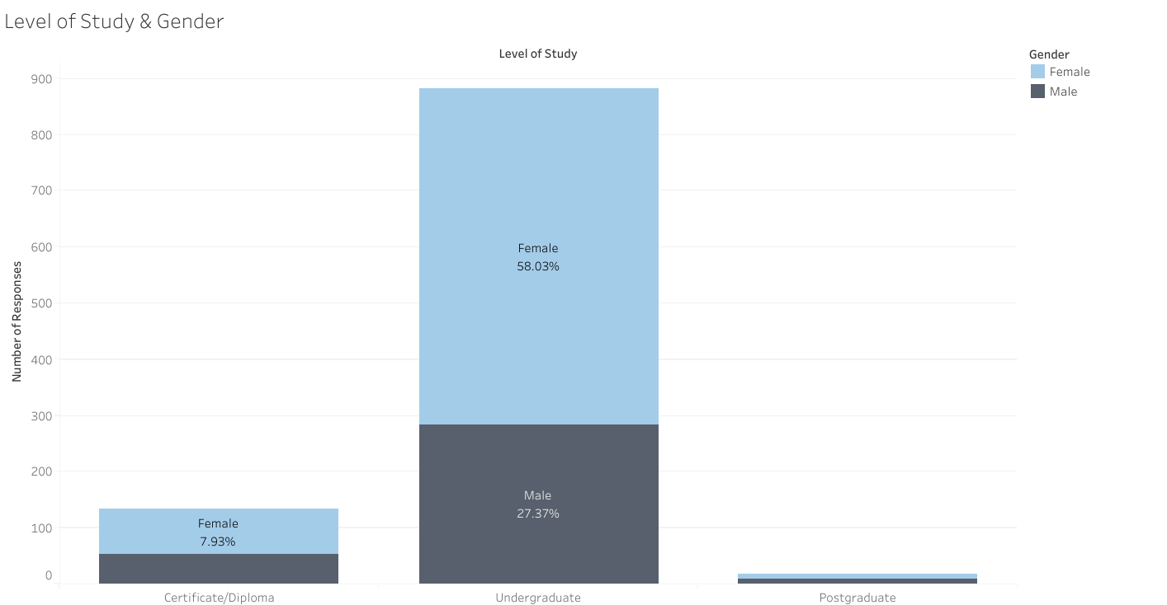
21
DS Methodology: Data Preparation 4.1
b. Level of study & Gender
Figure 14: Level of study and gender of respondents
Link to dashboard: General Distribution Dashboard
Notes:
From Fig 14, we can observe that undergraduate students are the most with female undergraduate students being the majority at 58%.

Slide 22
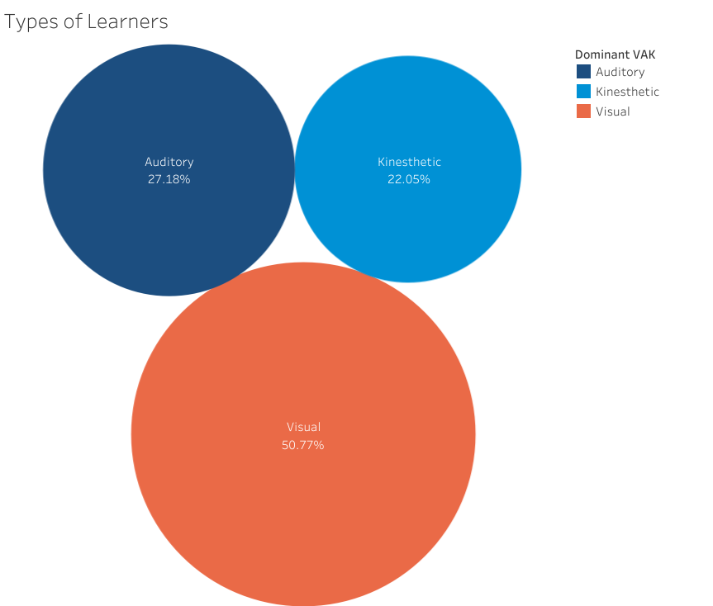
22
DS Methodology: Data Preparation 4.2
c. Dominant learning style distribution
Figure 15: Distribution of the types of learner
Link to dashboard: General Distribution Dashboard
Notes:
For the type of learners, Majority of the respondent, 50.7% are visual learners with kinesthetic learners being the least, 22.05%.

Slide 23
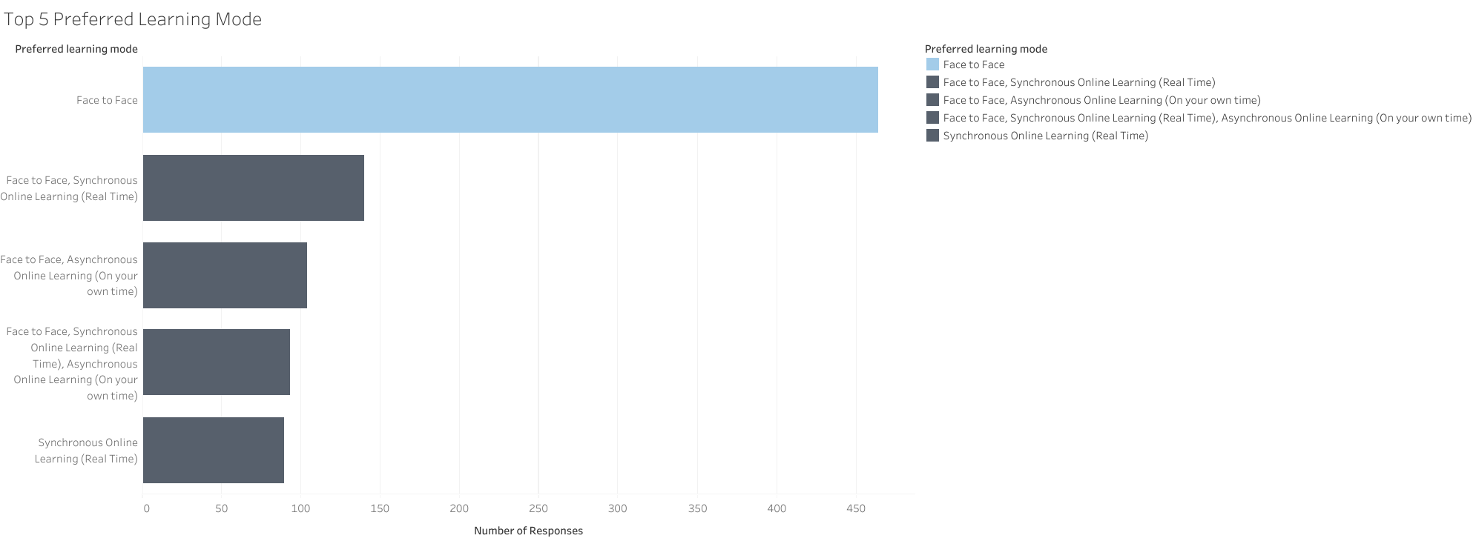
23
DS Methodology: Data Preparation 4.3
d. Preferred learning mode
Figure 16: Preferred learning mode by visual, auditory and kinesthetic learners
Link to dashboard: General Distribution Dashboard
Notes:
Fac-to-face is the most preferred learning mode by all respondents

Slide 24
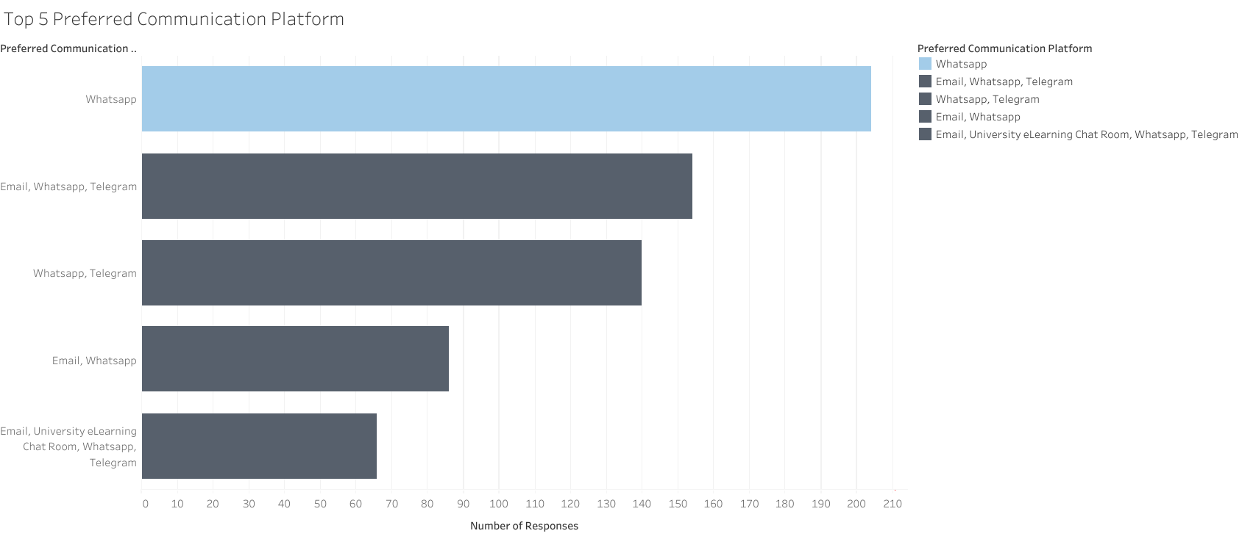
24
DS Methodology: Data Preparation 4.4
e. Preferred communication platform
Figure 17: Top 5 preferred communication platform by visual, auditory and kinesthetic learners
Link to dashboard: General Distribution Dashboard
Notes:
The most preferred communication platform for students are whatsapp.

Slide 25
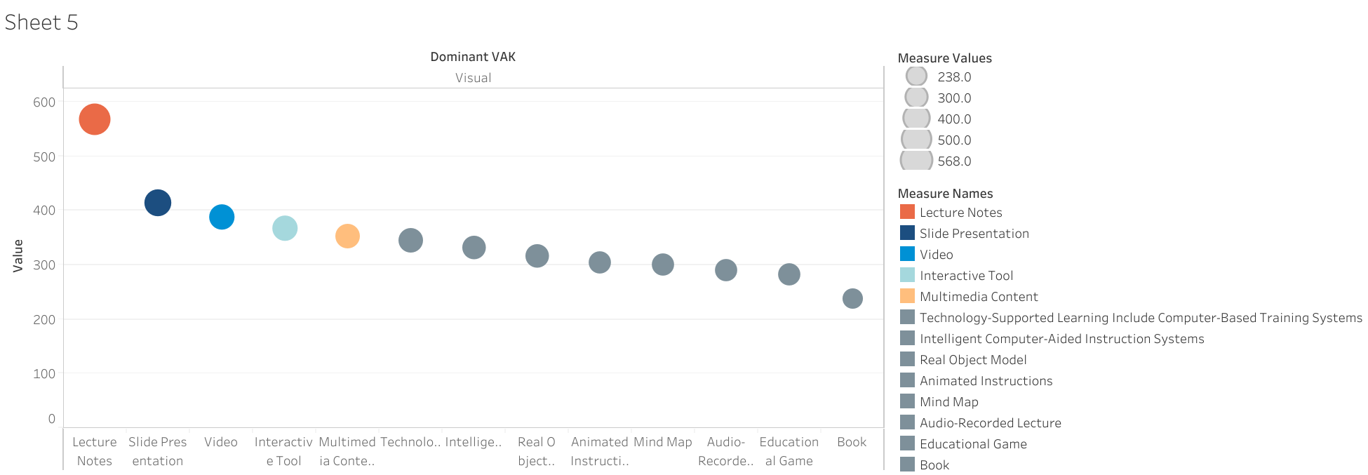
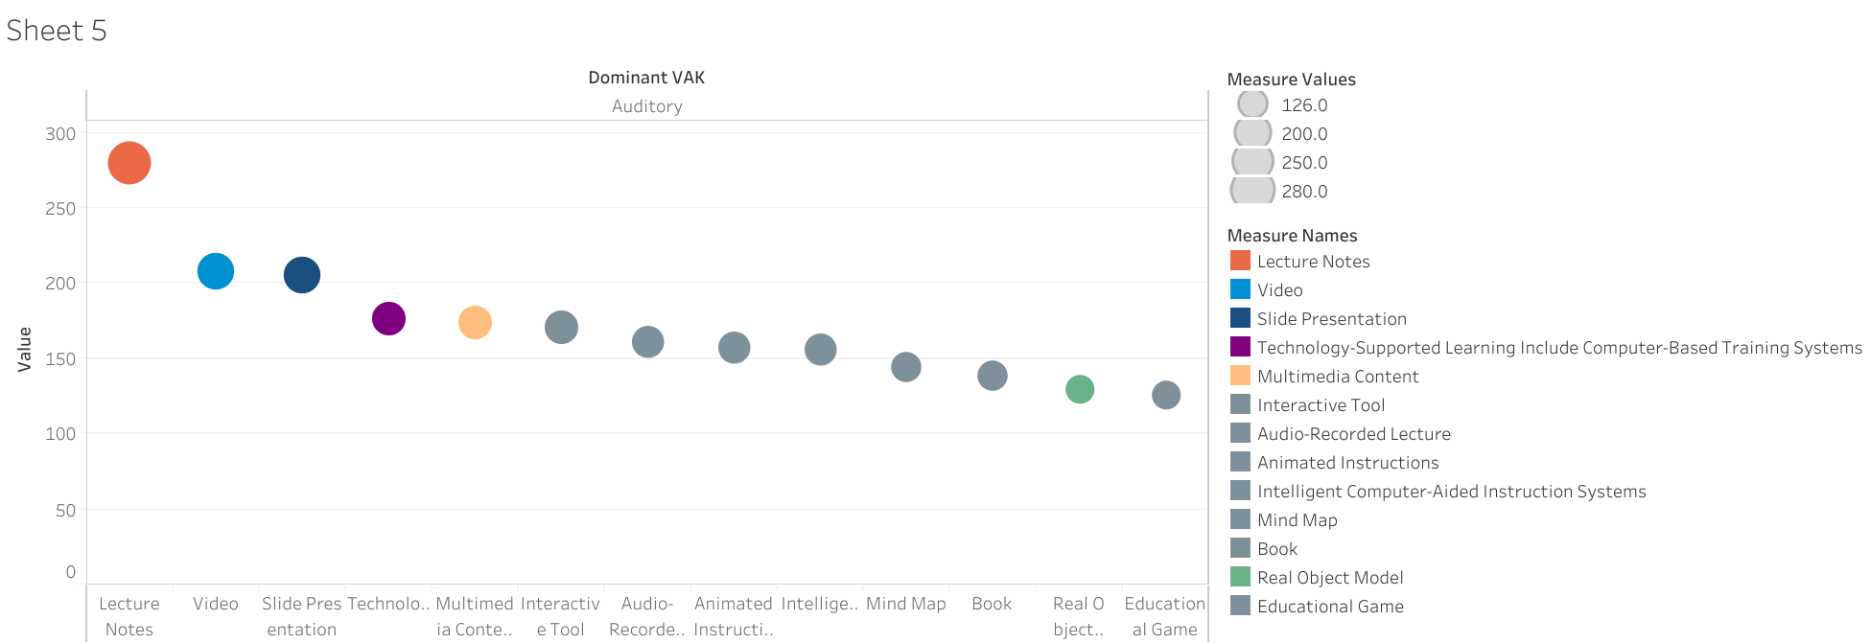
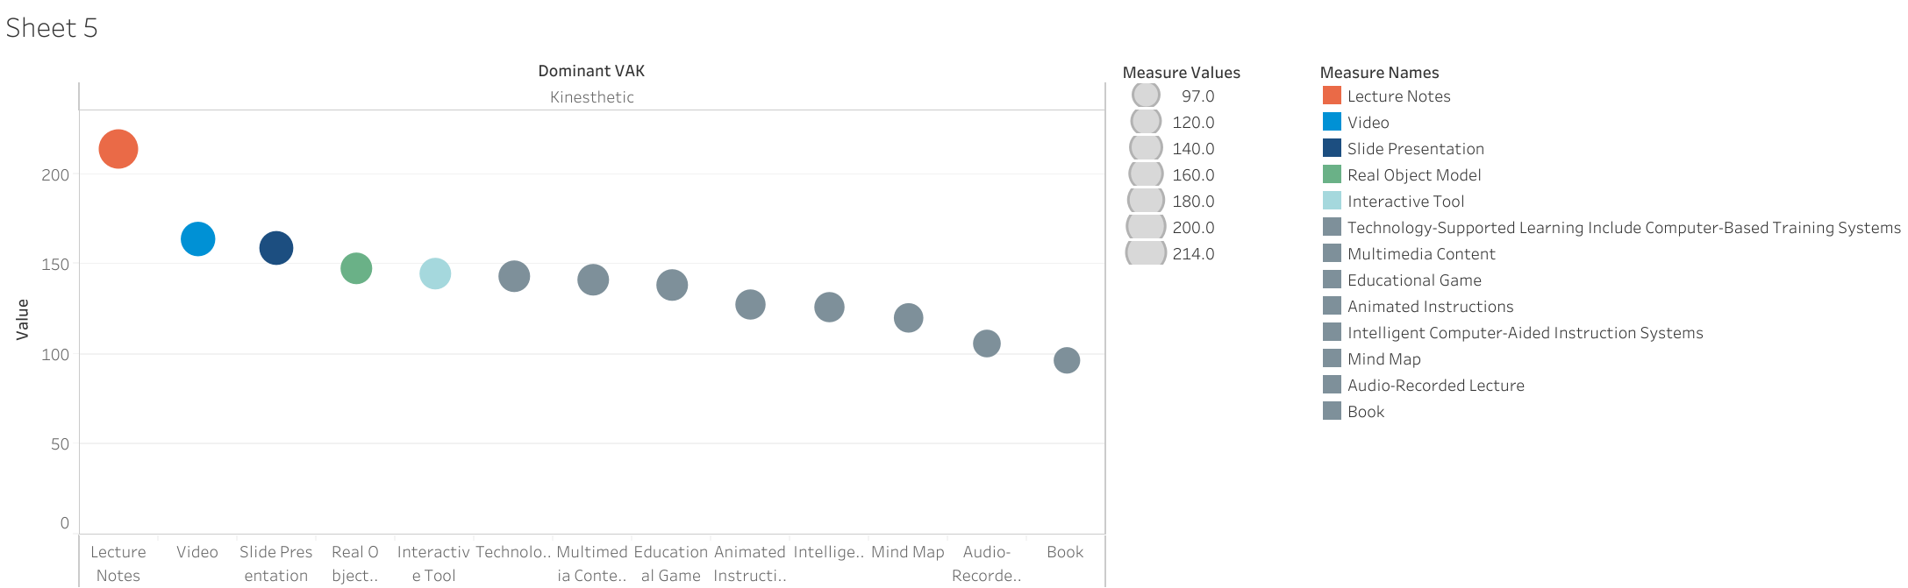
25
DS Methodology: Data Preparation 4.5
Figure 18: Learning object preference by visual learners
Figure 19: Learning object preference by auditory learners
f. Learning objects preferences
All 3 learning styles have similar top 3 preferences.
Lecture Notes
Slides Presentation
Video
Figure 20: Learning object preference by kinesthetic learners
Link to dashboard: Learning Objects Preferences
Notes:
For the learning object preferences, overall, we can observe that all 3 learning styles have similar top 3 preferences of lecture notes, slide presentations and video.
Now, let us dive deeper into the preferences of each learning style.

Slide 26
26
DS Methodology: Data Preparation 4.6
g. Visual learners’ learning objects preferences
Figure 21: Learning object preference by visual learners
Visual materials like animated instructional and mind maps are less preferred for visual learners.
Link to dashboard: Learning Objects Preferences
Notes:
Visual learners do not necessarily like all types of visual materials. As observed in Figure 21, visual materials like animated instructional and mind maps are less preferred.

Slide 27
27
DS Methodology: Data Preparation 4.7
h. Auditory learners’ learning objects preferences
Figure 22: Learning object preference by auditory learners
Auditory materials like audio-recorded lectures are less preferred for auditory learners.
Link to dashboard: Learning Objects Preferences
Notes:
Similarly, Audio materials like audio-recorded lectures are less preferred for auditory learners.

Slide 28
28
DS Methodology: Data Preparation 4.8
i. Kinesthetic learners’ learning objects preferences
Figure 23: Learning object preference by kinesthetic learners
Hands-on learning objects such as intelligent computer-aided are less preferred for kinesthetic learners.
Link to dashboard: Learning Objects Preferences
Notes:
kinesthetic learners also do not necessarily prefer all types of hands-on learning objects.
Hence, this emphasises the need to take students learning object preferences into account when recommending learning objects for each learning style.

Slide 29
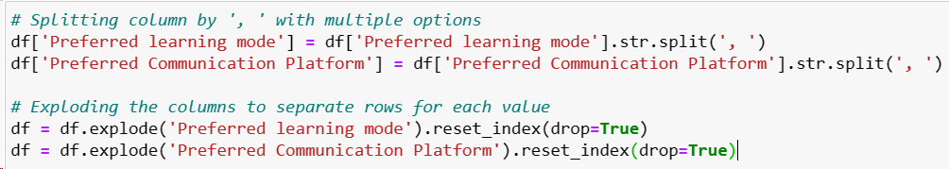
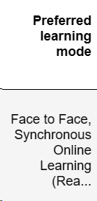
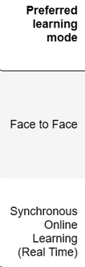
29
DS Methodology: Data Preparation 5
08.
Data
Exploding
For multiple option questions
a. Split options by comma.
Figure 24: Code snippet of splitting the answers from the column with multiple options
After
exploding
b. Perform ‘explode’.
Sample
1 single row
2 separate rows
Figure 25: Code snippet of exploding the answers from the column with multiple options
Figure 26: Before and after performing the ‘explode’
Notes:
For questions with multiple options, we need to separate them into a single option for better processing by exploding them into individual rows.
Figure 26 shows the before and after performing data exploding.

Slide 30
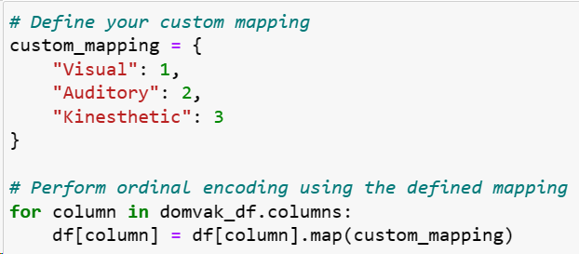
30
DS Methodology: Data Preparation 6
a. Ordinal encoding
Perform for columns that have an order or require custom mappings
Gender
Level of Study
Household income
Learning objects preferences
Dominant learning style
09.
Data
Encoding
b. One-hot encoding
Perform for the rest of the columns
Figure 28: Performed one-hot encoding on the VAK questions columns
Figure 27: Sample of performing ordinal encoding
Notes:
As all of our columns are categorical data, they need to be encoded before modelling can be performed
Ordinal encoding is performed for columns where the order is important while one-hot encoding is performed for the remaining columns.

Slide 31
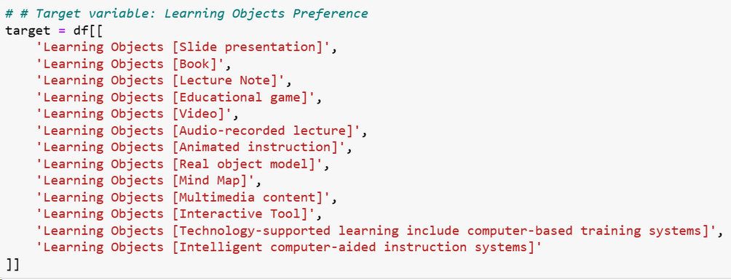
31
DS Methodology: Modelling 1
a. Target variable are the learning objects
10.
Define target
variables
Figure 29: Code snippet on defining target variables
11.
Split test and train data
a. Split training & test sets
test 25%, train 75%
Figure 30: Code snippet of splitting data into train & test
Notes:
Next, target variables are define before data is split into 25% test and 75% train.

Slide 32




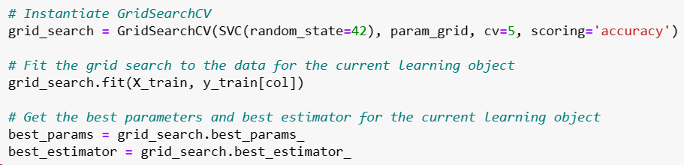
32
DS Methodology: Modelling 2
12.
Train, fit classification models
a. Total of 6 models
Support Vector Machine (SVM)
Random Forest
Decision Tree
eXtreme Gradient Boosting (XGB)
K-Nearest Neighbour (kNN)
Logistic Regression
b. Utilised GridSearchCV()
To find the best parameters for each model
Figure 31: Sample of implementing GridSearchCV in training, fitting and finding the best parameters of the model
Notes:
6 models are trained namely, ...
The gridsearchcv() function is utilised in training and fitting the models to find the best parameters of each model.

Slide 33
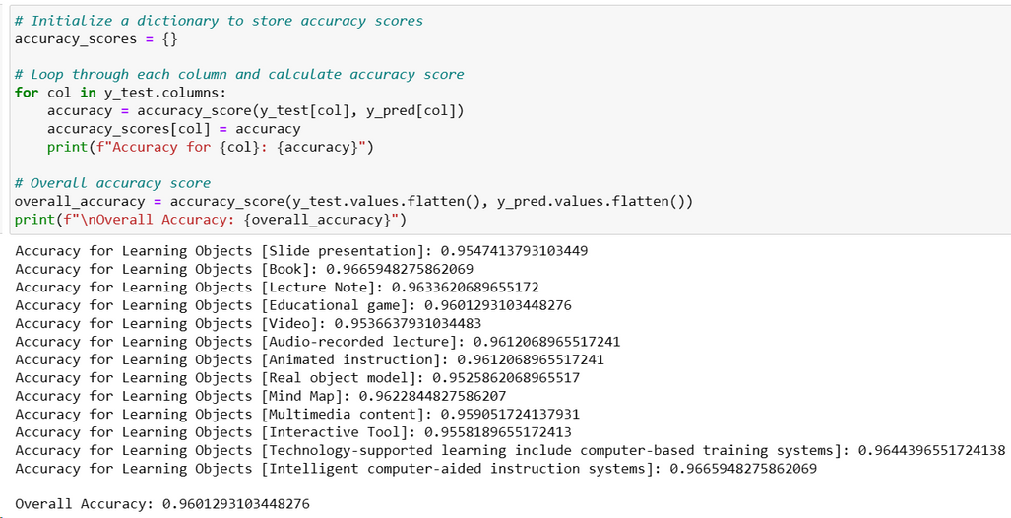
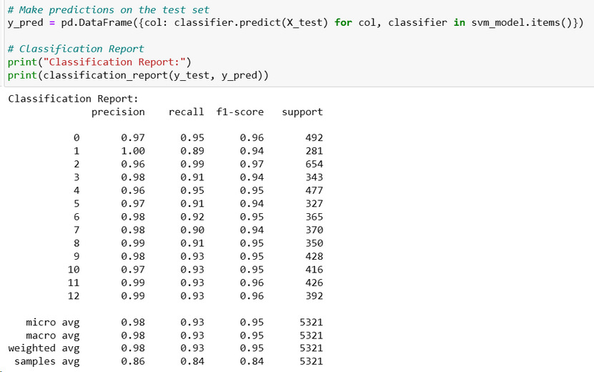
33
DS Methodology: Evaluation
a. Accuracy score
Represents a proportion of correct predictions made by a model
13.
Evaluate the models
b. Classification report
Macro-averaging: All classes are equally important
Figure 32: A sample of performing accuracy score on a model
Figure 33: A sample of performing classification report on a model
Notes:
The accuracy score and classification report is used in evaluating the models. Accuracy score gives us the proportion of correct predictions made by a model. Macro-averaging is selected in the classification report as all classes are equally important

Slide 34
34
DS Methodology: Evaluation Results
c. Model evaluation results
Support Vector Machine (SVM) has the highest accuracy. Thus, it is the best model.
Model | Accuracy Score | Precision | Recall | F1-score
SVM | 0.9601 | 0.98 | 0.93 | 0.95
Random Forest | 0.9598 | 0.98 | 0.92 | 0.95
kNN | 0.9569 | 0.96 | 0.94 | 0.95
XGB | 0.9441 | 0.96 | 0.91 | 0.93
Decision Tree | 0.9382 | 0.92 | 0.93 | 0.93
Logistic Regression | 0.6642 | 0.62 | 0.52 | 0.55
Best model
Table 4: Accuracy score and classification report results of each model
Notes:
The results are tabluated in table 4. SVM has the highest accuracy of 0.96, precison 0.98, recall 0.93 and f1 score of 0.95. Thus, it is the best model.

Slide 35

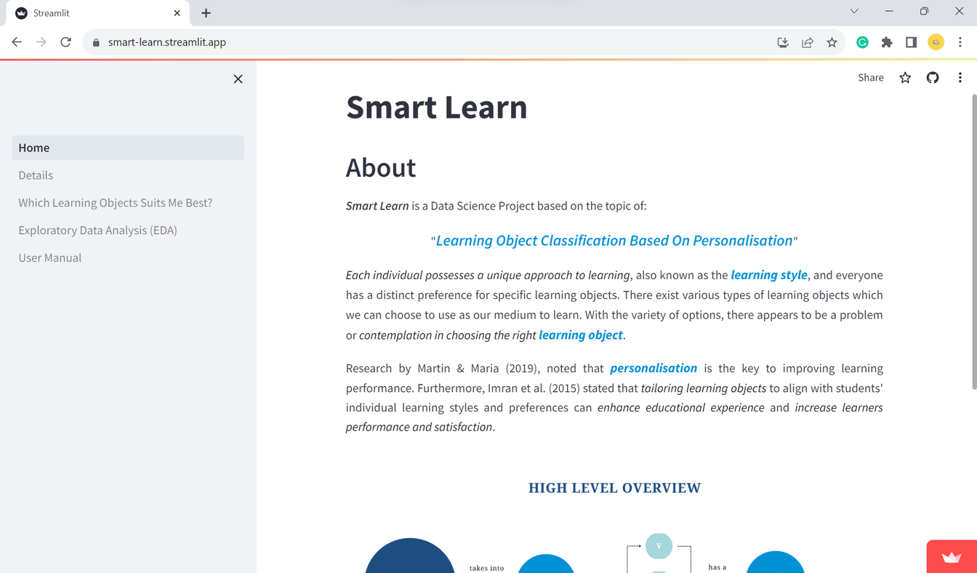
35
DS Methodology: Deployment
a. Deployed a website, Smart Learn
Utilised Streamlit
14.
Deploy the
data product
Figure 34: Smart Learn ‘s homepage
Notes:
A website called smart learn is developed and deployed with streamlit.

Slide 36
36
DS Methodology: Summary
a. Acquire data
b. Identify relevant columns
a. Understand the problem
Business Understanding
Data Understanding
a. Standardise data
b. Identify dominant
learning style
c. EDA
d. Encode data
Data
Preparation
a. Web application
Data
Deployment
Modelling
a. SVM
b. Random Forest
c. Decision Tree
a. Accuracy score
b. Classification report
Evaluation
d. XGB
e. kNN
f. Logistic Regression
Notes:
Let me summarise the methodology.

Slide 37
37
DS Methodology: Summary
a. Acquire data
b. Identify relevant columns
a. Understand the problem
Business Understanding
Data Understanding
a. Standardise data
b. Identify dominant
learning style
c. EDA
d. Encode data
Data
Preparation
a. Web application
Data
Deployment
Modelling
a. SVM
b. Random Forest
c. Decision Tree
a. Accuracy score
b. Classification report
Evaluation
d. XGB
e. kNN
f. Logistic Regression
Notes:
Business understanding involves understanding the problem.

Slide 38
38
DS Methodology: Summary
a. Acquire data
b. Identify relevant columns
a. Understand the problem
Business Understanding
Data Understanding
a. Standardise data
b. Identify dominant
learning style
c. EDA
d. Encode data
Data
Preparation
a. Web application
Data
Deployment
Modelling
a. SVM
b. Random Forest
c. Decision Tree
a. Accuracy score
b. Classification report
Evaluation
d. XGB
e. kNN
f. Logistic Regression
Notes:
Data understanding involves...

Slide 39
39
DS Methodology: Summary
a. Acquire data
b. Identify relevant columns
a. Understand the problem
Business Understanding
Data Understanding
a. Standardise data
b. Identify dominant
learning style
c. EDA
d. Encode data
Data
Preparation
a. Web application
Data
Deployment
Modelling
a. SVM
b. Random Forest
c. Decision Tree
a. Accuracy score
b. Classification report
Evaluation
d. XGB
e. kNN
f. Logistic Regression
Notes:
Data preparation involves...

Slide 40
40
DS Methodology: Summary
a. Acquire data
b. Identify relevant columns
a. Understand the problem
Business Understanding
Data Understanding
a. Standardise data
b. Identify dominant
learning style
c. EDA
d. Encode data
Data
Preparation
a. Web application
Data
Deployment
Modelling
a. SVM
b. Random Forest
c. Decision Tree
a. Accuracy score
b. Classification report
Evaluation
d. XGB
e. kNN
f. Logistic Regression
Notes:
Modelling covers ...

Slide 41
41
DS Methodology: Summary
a. Acquire data
b. Identify relevant columns
a. Understand the problem
Business Understanding
Data Understanding
a. Standardise data
b. Identify dominant
learning style
c. EDA
d. Encode data
Data
Preparation
a. Web application
Data
Deployment
Modelling
a. SVM
b. Random Forest
c. Decision Tree
a. Accuracy score
b. Classification report
Evaluation
d. XGB
e. kNN
f. Logistic Regression
Notes:
In evaluation. accuracy score and classification report is utilised.

Slide 42
42
DS Methodology: Summary
a. Acquire data
b. Identify relevant columns
a. Understand the problem
Business Understanding
Data Understanding
a. Standardise data
b. Identify dominant
learning style
c. EDA
d. Encode data
Data
Preparation
a. Web application
Data
Deployment
Modelling
a. SVM
b. Random Forest
c. Decision Tree
a. Accuracy score
b. Classification report
Evaluation
d. XGB
e. kNN
f. Logistic Regression
Notes:
Lastly, a web application is deployed.

Slide 43
43
Summary of Tools Used

Slide 44
44
Showcasing Smart-Learn

Slide 45
45
Conclusion
Objective | Approach/Results | Status
To develop a learning object classification based on personalisation model | Model: SVM Random Forest Decision Tree XGB kNN Logistic Regression
To evaluate a learning object classification based on personalisation model | Evaluation metrics: Accuracy score Classification report Best model: SVM
To develop a functional data product web application which can provide learning objects recommendation | Web application: Smart Learn
Achieved
Achieved
Achieved
Table 5: Status of objectives achievement
Notes:
In conclusion, all of our defined objectives have been achieved.
Models have been built.
Evaluation of the model is done using accuracy score and classification report
web application, smart learn, is deployed.

Slide 46
46
Thank you!
Notes:
And with that, that is all from me, thank you.

